Slide 1
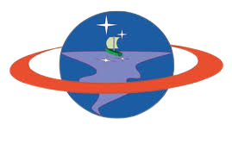
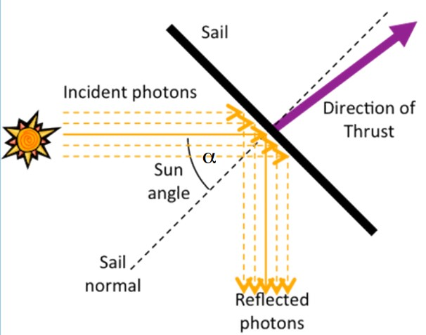
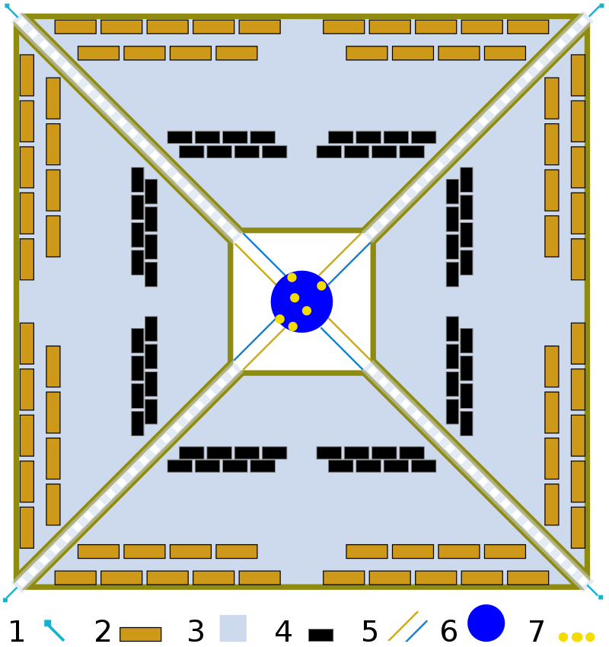
Slide 1
Solar Sail Propulsion
for Deep Space Nanosatellites
Femi Ishola
Email: ishola.Mustapha-femi741@mail.Kyutech.jp Blog site: http://femi.phemotron.com
Laboratory of Spacecraft Environment Interaction Engineering, Kyushu Institute of Technology, Japan
Rocket Propulsion Course Poster Session. 30th July, 2019.
1
Inter
Abstract
Interplanetary travel is very challenging for chemical propulsion systems due to limits on amount of
propellant that can be accommodated on the launching rocket stages and onboard the satellite. Nuclear
-assisted propulsion systems have been utilized on deep space missions like the Voyager Spacecrafts but
accompanied by several operational constraints. Nanosatellites have become the platform of choice for science
missions by low budget educational and research institutions. Currently there are thousands of Nanosatellites in
the near-Earth space which were mostly launched as piggy-backed payloads to orbit while they used onboard
miniaturized chemical thrusters for on-orbit maneuvers. The MarCOs were the first nanosatellite to reach
Mars Orbit using a cold gas micro propulsion system. Solar Sail propulsion offers cheaper, light-weight,
propellant-less alternative to explore many regions of the solar system.
2
Theory & Operating Principle
Solar Sail propulsion is possible because of the ‘’photon pressure’’ phenomena.
Incident photons from sunlight on a sufficiently large and thin reflective
surface creates a momentum, a resultant force approximately
perpendicular to the surface.
The force is small (about 9N per square kilometer of Sail at LEO)
but with constant acceleration and unlimited ΔV.
The pressure, P on the reflector as a function of distance and incidence angle
The Characteristic acceleration and Sail loading are given by the relations:
$$σ=\frac{M_{s}}{A^{∗}}$$
$$g/m^{2}$$
The Sail material are lightweight, ultra thin film (μm). Examples are Mylar and Aluminized Kapton
Attitude control can be achieved by tilting the Sail’s Centre of pressure and spacecraft Centre of mass
Page 1 of 3

Slide 2
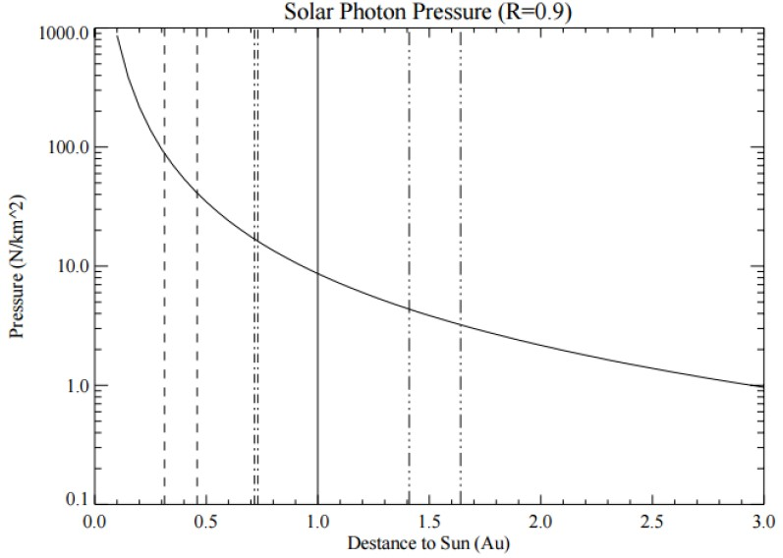
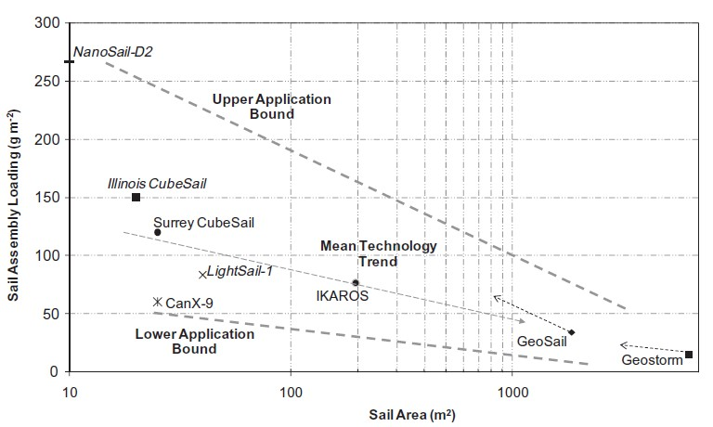
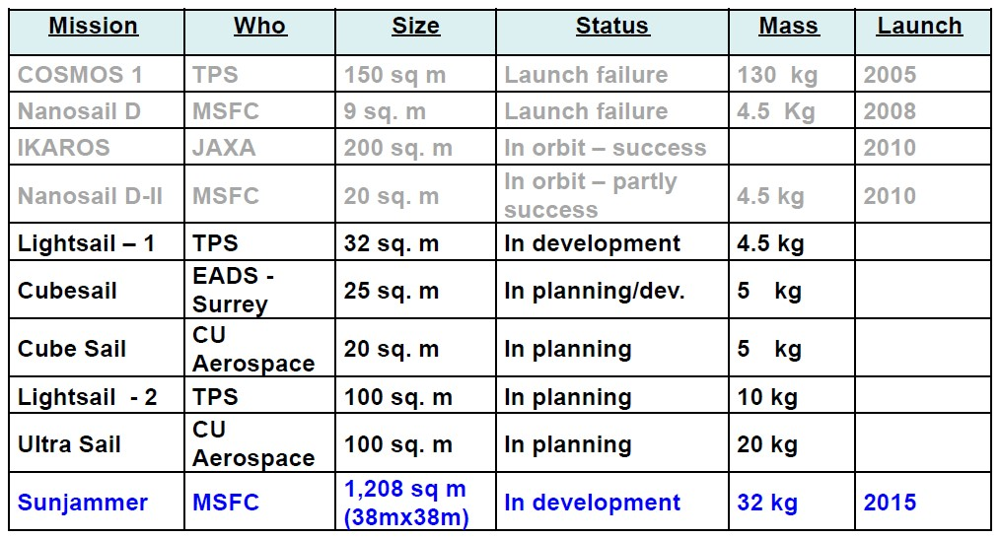
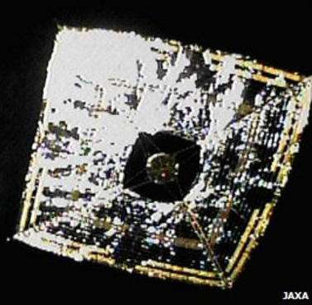
Slide 1
3
State-of-the-Art
Ikaros’ Sail fully deployed in space
Page 2 of 3

Slide 3
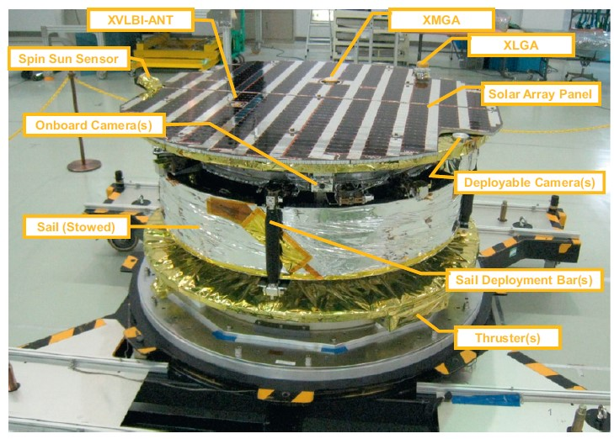
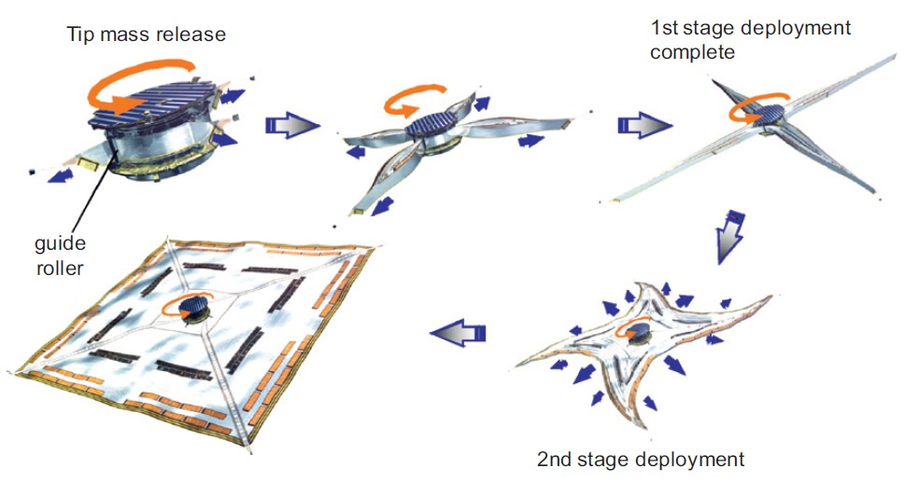
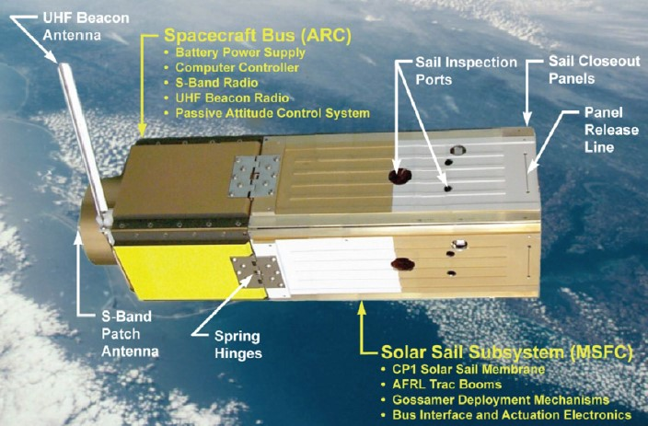
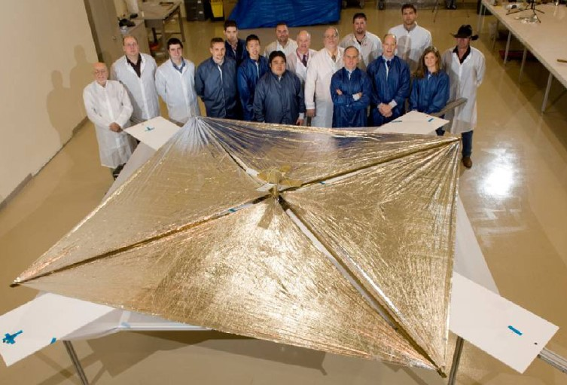
Slide 1
Ikaros flight model before launch
Ikaros deployment scheme
NanoSail-D
NanoSail-D ground deployment test
4
Conclusion
The Sun exerts meaningful solar pressure on large and thin Sails which generate propulsive thrust for lightweight Spacecrafts in the inner segment of the solar system. Acceleration by photon pressure is very limited in the outer segment of the Solar system beyond the orbit of Jupiter because of extremely low solar irradiance levels. For Interstellar distances, combination of Solar Sail and electric propulsion systems like the efficient ion or plasma thrusters could be very effective.
5
[1] J. A. Atchison and M. A. Peck, “A passive, sun-pointing, millimeter-scale solar sail,” Acta Astronautica, vol. 67, no. 1–2, pp. 108–121, Jul. 2010.
[2] Y. Tsuda et al., “Achievement of IKAROS — Japanese deep space solar sail demonstration mission,” Acta Astronautica, vol. 82, no. 2, pp. 183–188, Feb. 2013.
[3] I. Funaki, “Overview of Sail Propulsion for Space Flight,” p. 42.
[4] M. Macdonald and C. McInnes, “Solar sail science mission applications and advancement,” Advances in Space Research, vol. 48, no. 11, pp. 1702–1716, Dec. 2011.
[5] L. Johnson, R. Young, E. Montgomery, and D. Alhorn, “Status of solar sail technology within NASA,” Advances in Space Research, vol. 48, no. 11, pp. 1687–1694, Dec. 2011.
[6] J. Les, “20120015076.pdf.” [Online]. Available: https://ntrs.nasa.gov/archive/nasa/casi.ntrs.nasa.gov/20120015076.pdf. [Accessed: 27-Jul-2019].
[7] J. Les, “20160005683.pdf.” [Online]. Available: https://ntrs.nasa.gov/archive/nasa/casi.ntrs.nasa.gov/20160005683.pdf. [Accessed: 27-Jul-2019].
References
Page 3 of 3

